Slide 1
Brave New World Project
Creating a Utopian Society

Slide 2
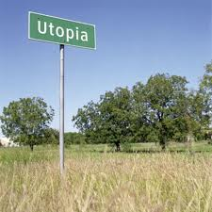
Overview of Project
As an extension of the novel Brave New World, you will be creating a "utopian" society with a partner. The society presented in our story is a fictional account of a futuristic totalitarian community that has arisen many years after the devastation of the "9 years War" that has almost wiped out the Earth and all humanity. YOUR society does not have to start this way. This is your opportunity to be creative!

Slide 3
Steps for this Activity
You will first review the links provided to review the definition of utopia and utopian societies.
Next, partners will brainstorm ideas for each required section of the presentation.
A handwritten or typed preview of the project must be approved by me before you begin to create your PowerPoint presentation.
Sign-up for your presentation day.
Create your presentation (minimum of ten slides).
Review and edit presentation as necessary.

Slide 4
Content of Slides
Introductory slide(s) that includes a definition of the word utopia, the name of the society created, how this society came to be (war, natural disaster, etc.) and a flag representing your society.
In addition, each group will have to include a slide that describes how their utopia handles each of the following areas (you only need to choose eight):
Religion
Educational system
Economy
Rituals/Traditions
Law and Order
Transportation
Entertainment
Form of government
Societal Structure
Family Structure
* Each slide must have a corresponding picture that represents the section discussed.

Slide 5
Helpful Links
Brave New World Sparknotes
Utopians - Wikipedia
Utopia Definition
How to Write a Preamble
Utopian/Dystopians
Utopian Societies

Slide 6
Hopeville USA A Utopian Society Example

Slide 7
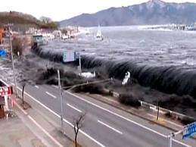
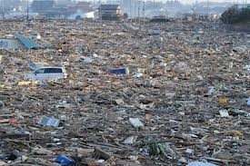
Utopia – A perfect world
Background
* Hopeville USA was created in 2075 AMN (After Mother Nature) after 40 years of devastation due to a series of natural disasters that began with a 9.5 earthquake located in central California. Subsequent earthquakes were triggered as well as numerous tsunami’s. Half of the world’s population died in the initial disasters, and a quarter more perished over the following few years due to disease and famine.

Slide 8
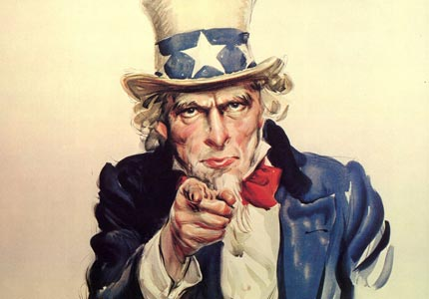
System of Government
The basis for the Utopian government in
Hopeville is Communism.
Everyone is equal and works for the common good of the whole.
The community is of vital importance.
There is no individualism because it creates conflict and dissent among the people.

